Slide 1

Reactive Programming
SoftUni Team
Technical Trainers
Software University
https://softuni.bg

Slide 2
Table of Contents
What is reactive programming
Intro to Spring WebFlux
Working with Flux and Mono
Programming Models

Slide 3
Have a Question?
sli.do #java-web

Slide 4

What is Reactive Programming

Slide 5
Reactive Programming
Is a model of coding where communication happens through a non-blocking stream of data
Makes code "reactive", reacting to change and not being blocked, such as performing operations that read/wait for responses from a database or file
Can react to events as data becomes available
Using it we can use effective resources utilization (CPU cores) for computing

Slide 6
Reactive Programming (2)
It's principles are based on the Reactive Manifesto
It is build around publisher-subscriber pattern (observer pattern)
In non-blocking code, the Back pressure becomes important to control the rate of events so that a fast producer does not overwhelm its destination

Slide 7
Blocking vs Non-blocking(Traditional MVC)
Presentation Layer
Database Layer
Core
Request #1
Servlet Thread #1
blocked
Worker Thread #1
unblocked
Request #2
Worker Thread #2
DB
Servlet Thread #2
blocked
Worker Thread #3
Request #3
Servlet Thread #3
blocked

Slide 8
Blocking vs Non-blocking(2)
Presentation Layer
Database Layer
Request #1
Event
Handler
Event with Callback
Fixed/Small No. of Threads
DB
Callback Execution
Event

Slide 9
Reactive Streams and Reactor
Reactive Streams: is a specification that defines how an API that implements and follows the Reactive Programming paradigm should work
Reactor: is a Java implementation of the Reactive Streams specification
Spring WebFlux is the "reaction" of Spring for this paradigm to use on web applications

Slide 10
Reactive Streams VS Java 8 Streams
The core difference is that Reactive is a push model, whereas the Java 8 Streams are a pull model
In reactive events are pushed to the subscribers as they come in
Java 8 Streams - pulling all the data and returning a result
With Reactive we could have an infinite stream coming in from an external resource, with multiple subscribers attached

Slide 11
Reactive Stream APIs
As per Java 9 and reactive specification below are API we need to use for reactive implementation
Publisher - Emits a sequence of events to subscribers according to the demand received from its subscribers
Subscriber - Receives&Processes events emitted by a Publisher
Subscription - Defines a one-to-one relationship between a Publisher and a Subscriber
Processors - Represents a processing stage consisting of both a Publisher and a Subscriber and obeys the contracts of both

Slide 12
Spring 5 Reactive Building Blocks
WebFlux
Spring Data reactive library
Reactive IO
Nonblocking Servlet container
Spring security reactive API

Slide 13
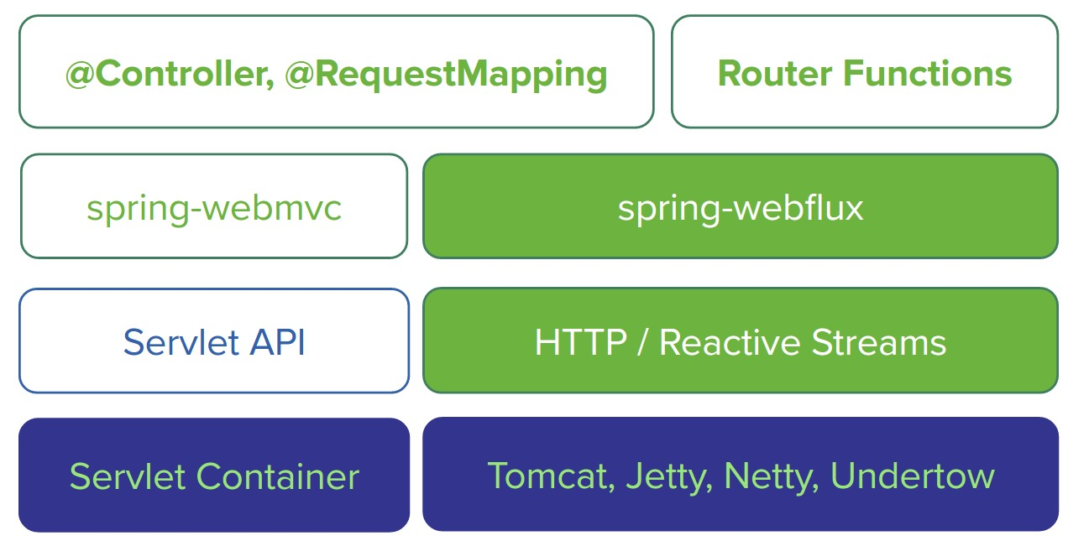
Spring 5 Reactive Building Blocks
Source - https://docs.spring.io/

Slide 14

Spring WebFlux

Slide 15
Spring WebFlux
Web framework that brings support for the reactive programming model
Implemented using the Project Reactor, and its publisher implementations — Flux and Mono, the library chosen by Spring
WebFlux is not a replacement for Spring MVC they can actually complement each other, working together on the same solution

Slide 16
Spring WebFlux Dependencies
Adding Spring WebFlux Dependency in pom
The Reactive Web dependency includes Spring WebFlux dependency
<dependency>
<groupId>org.springframework.boot</groupId>
<artifactId>spring-boot-starter-webflux</artifactId>
<version>...</version>
</dependency>

Slide 17
Mono and Flux
In WebFlux, the data returned from any operation is packed into a reactive stream
There are two types that embody this approach and are the building blocks in WebFlux:
Mono - is a stream which returns zero items or a single item (0..1)
Flux - is a stream which returns zero or more items (0..n)

Slide 18
Working with Mono and Flux
Mono/Flux.just()
The easiest way to emit an element is using the just method
Mono/Flux can have more than one subscribers
Mono.just(1).subscribe(System.out::println);
Flux.just(1,2,3).subscribe(System.out::println);
Flux<Integer> flux = Flux.just(1,2,3);
flux.subscribe(s->System.out.println("Subscr One-"+ s));
flux.subscribe(s->System.out.println("Subscr Two-"+ s));

Slide 19
Working with Mono and Flux (2)
Example of two subscribers with delay
Flux<Integer> flux = Flux.just(1,2,3);
flux
.map(n -> ++n)
.delayElements(Duration.ofMillis(500))
.subscribe(System.out::println);
flux
.delayElements(Duration.ofMillis(1000))
.subscribe(s-> System.out.println("Subscriber One-"+ s));

Slide 20
Working with Mono and Flux (3)
The subscribe method could accept other parameters as well to handle the error and completion calls
Flux.just(1,2,3)
.subscribe(
i -> System.out.println("Received :: " + i),
err -> System.out.println("Error :: " + err),
()->System.out.println("Successfully completed")
);

Slide 21
Programming Models

Slide 22
Programming Models
We can implement it in two ways:
Annotated Controllers
using Spring MVC annotations with minimum modifications
The old applications can also be converted to reactive nature and can use its features and benefits
Functional Endpoints
functional lambda style of programming

Slide 23
Annotated Controllers VS Func Endpoints
Annotated Controllers
Functional Endpoints
HTTP Request/Response
HTTP Request/Response
Rest Controller
Router
Service
Handler
Repository
Repository
Database
Database

Slide 24
Annotated Controllers
Similar to how we use controllers in classic Spring MVC
To mark a class as a controller, we use the @RestController annotation on a class level.
Having Spring WebFlux and the Reactor Core dependencies, in the class path, will let Spring know that the @RestController is in fact a reactive component and add support for Mono and Flux

Slide 25
Annotated Controllers Example
Annotated Controller Example
@RestController
@RequestMapping("/students")
public class StudentsControllers {
//Inject studentsService in constructor
@GetMapping("/all")
public Flux<Students> findAll(){
return studentsService.findAll();
}

Slide 26
Functional Endpoints
Spring WebFlux includes WebFlux.fn, a lightweight functional programming model in which functions are used to route and handle requests and contracts are designed for immutability
An HTTP request is handled with a HandlerFunction that takes ServerRequest and returns a delayed ServerResponse - Mono<ServerResponse>
Incoming requests are routed to a handler function with a RouterFunction - takes ServerRequest and returns a delayed HandlerFunction - Mono<HandlerFunction>

Slide 27
Functional Endpoints Example – Handler
Example of Student Handler
public class StudentHandler {
//...
public Mono<ServerResponse> getStudent(ServerRequest request) {
int studentId = Integer.valueOf(request.pathVariable("id"));
return repository.getStudent(studentId)
.flatMap(student -> ok().contentType(APPLICATION_JSON).bodyValue(student))
.switchIfEmpty(ServerResponse.notFound().build());
} //... }

Slide 28
Functional Endpoints Example – Router
Example of Router Function
//... Inject PersonHandler in constructor
RouterFunction<ServerResponse> router = router()
.GET("/student/{id}", accept(APPLICATION_JSON), handler::getStudent)
.GET("/student ", accept(APPLICATION_JSON), handler::listStudents)
.POST("/student ", handler::createStudent)
.build();

Slide 29
Spring WebFlux Configuration
The @Configuration and @EnableWebFlux annotations mark a class as a configuration class and Spring's bean management will register it
To use or extend the existing WebFlux configuration API, you can implement WebFluxConfigurer
@Configuration
@EnableWebFlux
public class Configuration implements WebFluxConfigurer {...}

Slide 30
Live Demo

Slide 31

Summary
…
…
…
Reactive Programming Is a model of coding where communication happens through a non-blocking stream of data
Webflux is a Web framework that brings support for the reactive programming model
Programming models
Annotated Controllers
Functional Endpoints

Slide 32
Questions?
Notes:
32

Slide 33
Trainings @ Software University (SoftUni)
Software University – High-Quality Education, Profession and Job for Software Developers
softuni.bg, about.softuni.bg
Software University Foundation
softuni.foundation
Software University @ Facebook
facebook.com/SoftwareUniversity
Software University Forums
forum.softuni.bg
Notes:
33

Slide 34

License
This course (slides, examples, demos, exercises, homework, documents, videos and other assets) is copyrighted content
Unauthorized copy, reproduction or use is illegal
© SoftUni – https://about.softuni.bg/
© Software University – https://softuni.bg
Notes:
34

